Slide 1
Communicative English
Spoken skills – Question tags

Slide 2
What are question tags ?
Question tags are short questions at the end of statements.
They are mainly used in speech when we want to:
confirm that something is true or not, or
to encourage a reply from the person we are speaking to.

Slide 3
How are the formed ?
Question tags are formed with the auxiliary or modal verb from the statement and the appropriate subject.
A positive statement is followed by a negative question tag.
Jack is from Spain, isn't he?
Mary can speak English, can't she?
A negative statement is followed by a positive question tag.
They aren't funny, are they?
He shouldn't say things like that, should he?

Slide 4
Rules to be followed
When the verb in the main sentence is in the present simple we form the question tag with do/does.
You play the guitar, don't you?
Alison likes tennis, doesn't she?
If the verb is in the past simple we use did.
They went to the cinema, didn't they?
She studied in New Zealand, didn't she
When the statement contains a word with a negative meaning, the question tag needs to be positive
He hardly ever speaks, does he?
They rarely eat in restaurants, do they?

Slide 5
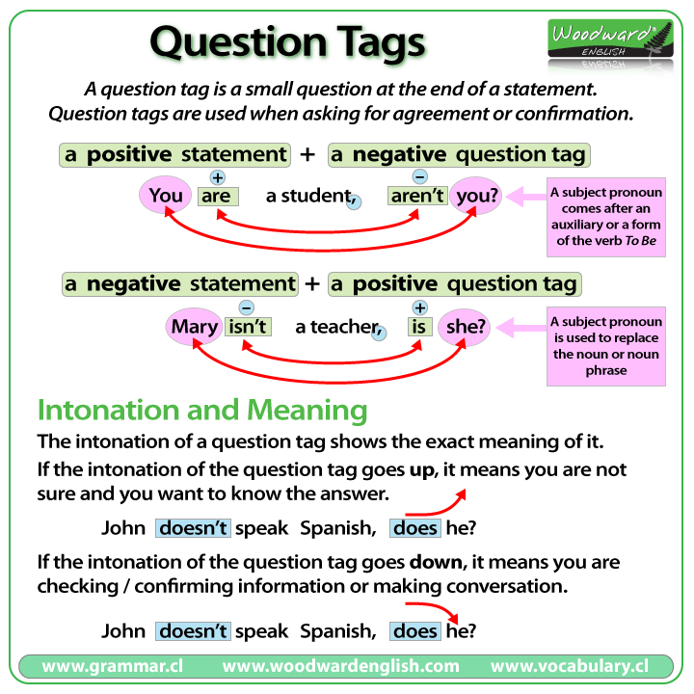

Slide 6
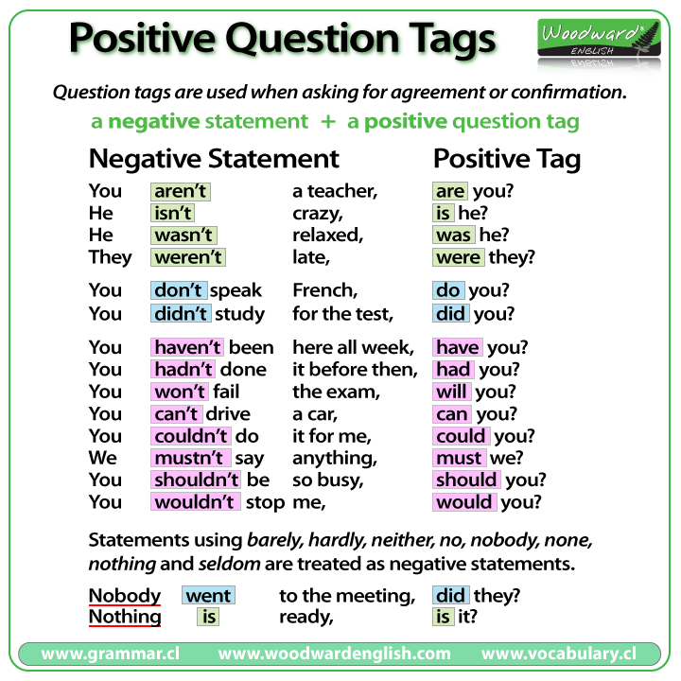

Slide 7
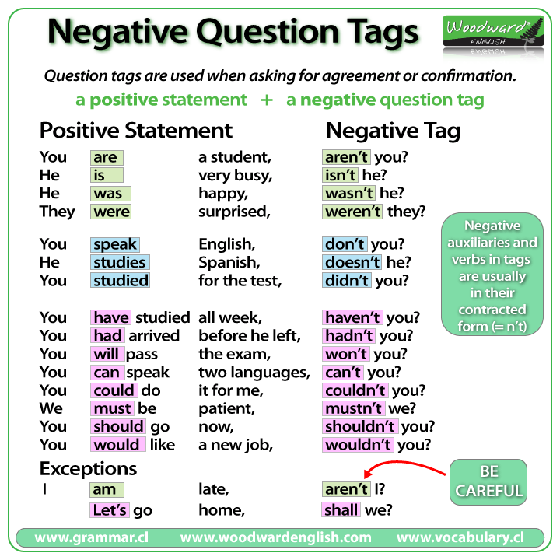

Slide 8
Exceptions
Some verbs / expressions have different question tags.
For example:
I am - I am attractive, aren't I?
Positive imperative - Stop daydreaming, will / won't you?
Negative imperative - Don't stop singing, will you?
Let's - Let's go to the beach, shall we?
Have got (possession) - He has got a car, hasn't he?
There is / are - There aren't any spiders in the bedroom, are there?
This / that is - This is Paul's pen, isn't it?

Slide 9
Speak confidently with the right word stress and intonation when question tags are added
- Thank you
Dr. Kiran Magavi

